Slide 1
CONTACTLESS DOORBELL
USING ARDUINO
PRESENTED By :
PRASAD R S {22AI037}
NAGAJOTHI T R {22IT024}
GOVARTHINI M {22IT009}
Guided By :
MRS.LALITHA K
TEAM NO 24
22AIP10 & INTERNET OF THINGS LABORATORY

Slide 2
Abstract
1.A contactless doorbell system using Arduino and an ultrasonic sensor.
2.Detects the presence of a person near the door without physical touch.
3. When a person approaches, the ultrasonic sensor signals the Arduino.
4. Arduino triggers a buzzer or relay-controlled doorbell to sound.
5. Provides a hygienic solution, reducing the risk of germ transmission.
6. Can be integrated with smart home systems for notifications or camera activation.

Slide 3
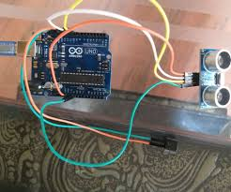
Objectives:
1.Design a contactless doorbell system using Arduino and an ultrasonic sensor.
2. Detect a person's presence and trigger a sound alert without touch.
3. Improve hygiene by eliminating physical contact with the doorbell.
-4.Create an efficient and scalable IoT solution for home automation.
-5.Enable integration with smart home systems for added functionality.

Slide 4
Components Required:
1. Arduino board (Uno, Nano, etc.)
2. Ultrasonic sensor (HC-SR04)
3. Buzzer or Speaker
4. Relay module (optional)
5. LEDs (optional)
6. Jumper wires
7. Breadboard
8. Power supply or USB cable

Slide 5
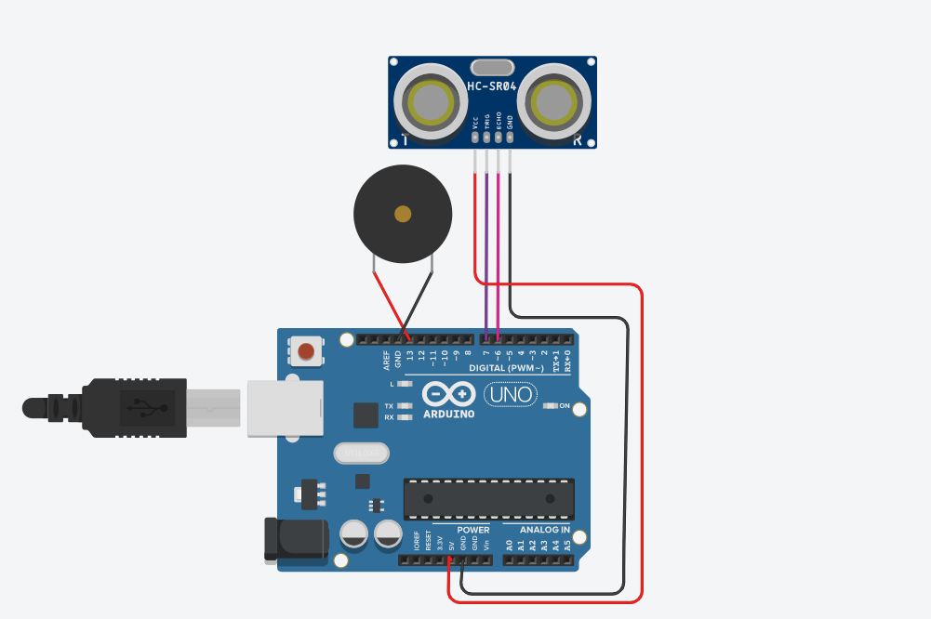
Flow Diagram:

Slide 6
Implementation: (Hardware or software)
1. Connect the Ultrasonic Sensor : to the Arduino using jumper wires, ensuring proper connections for VCC, GND, Trig, and Echo pins.
2. Wire the Buzzer : or relay module to the Arduino to act as the doorbell alert mechanism.
3. Upload the Arduino Code : that reads distance data from the ultrasonic sensor and triggers the buzzer or relay when a person is detected within the set range.
4. Test the System: to ensure the sensor accurately detects proximity and the buzzer activates as expected.
5. Optional : Integrate LEDs for visual feedback or additional smart home features, such as notifications or camera activation.
6. Assemble and Mount : the components in a suitable enclosure and install the system near the door for operation.

Slide 7
Thank you

